Slide 1

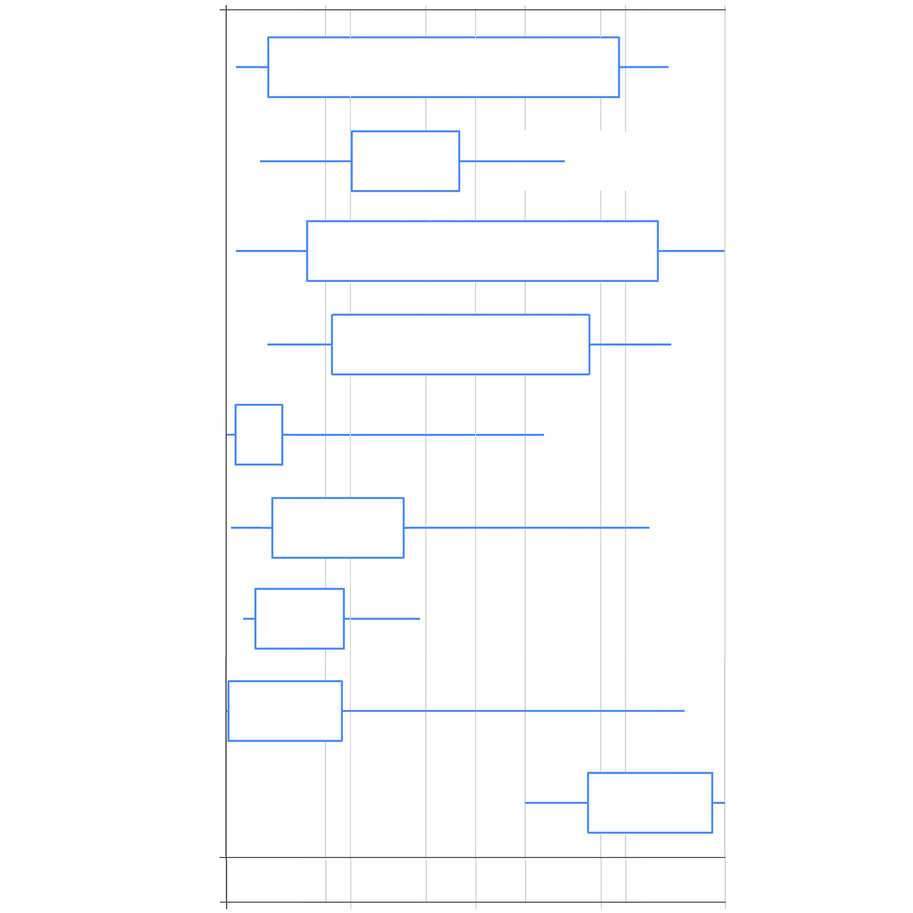
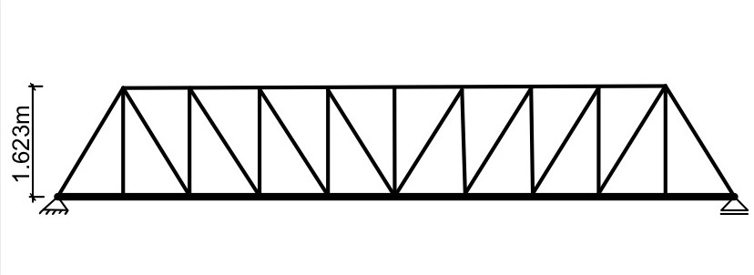
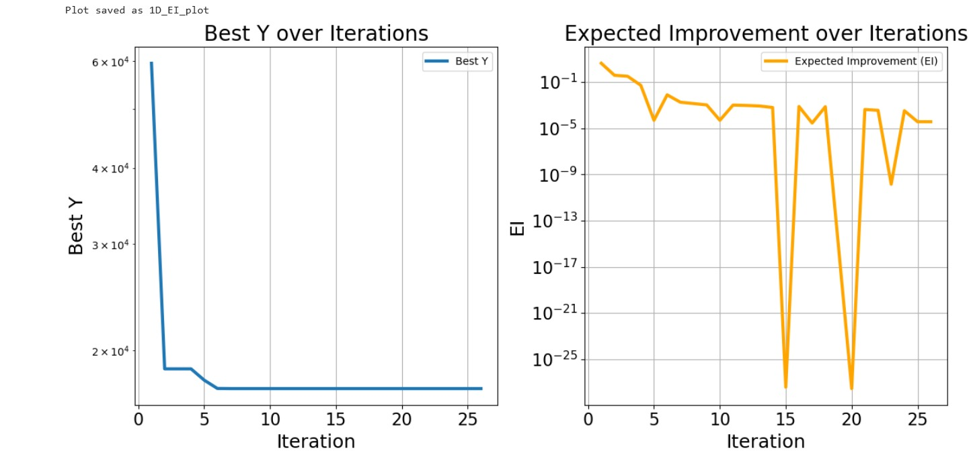
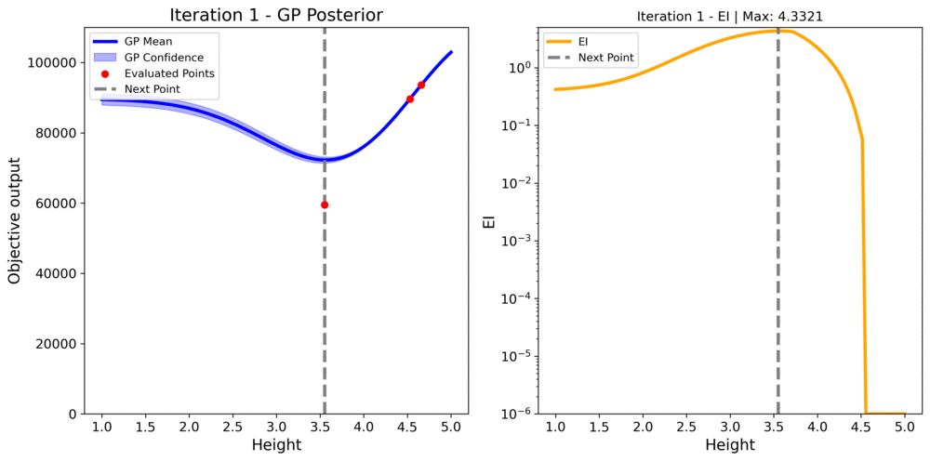
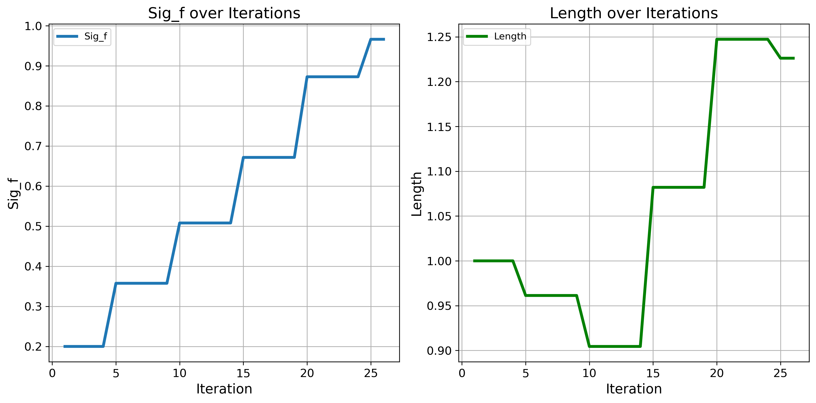
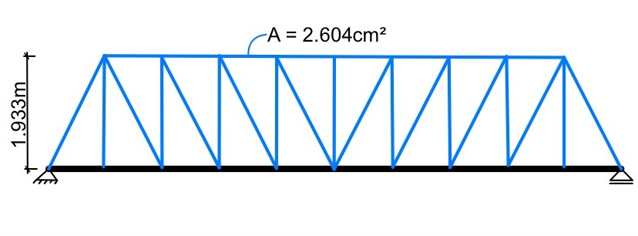
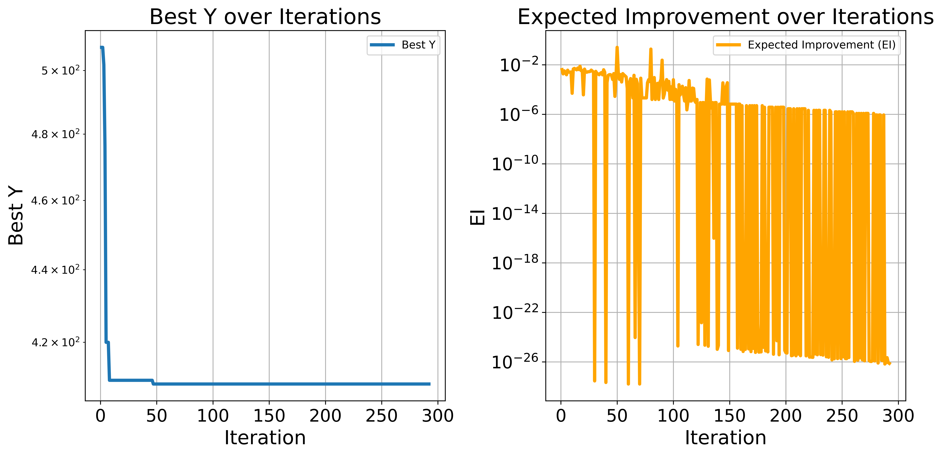
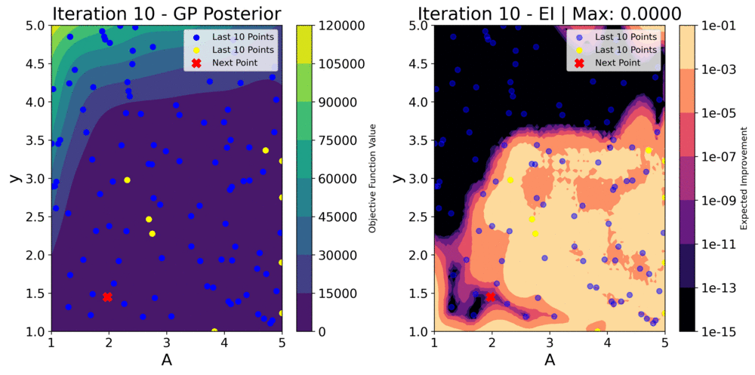
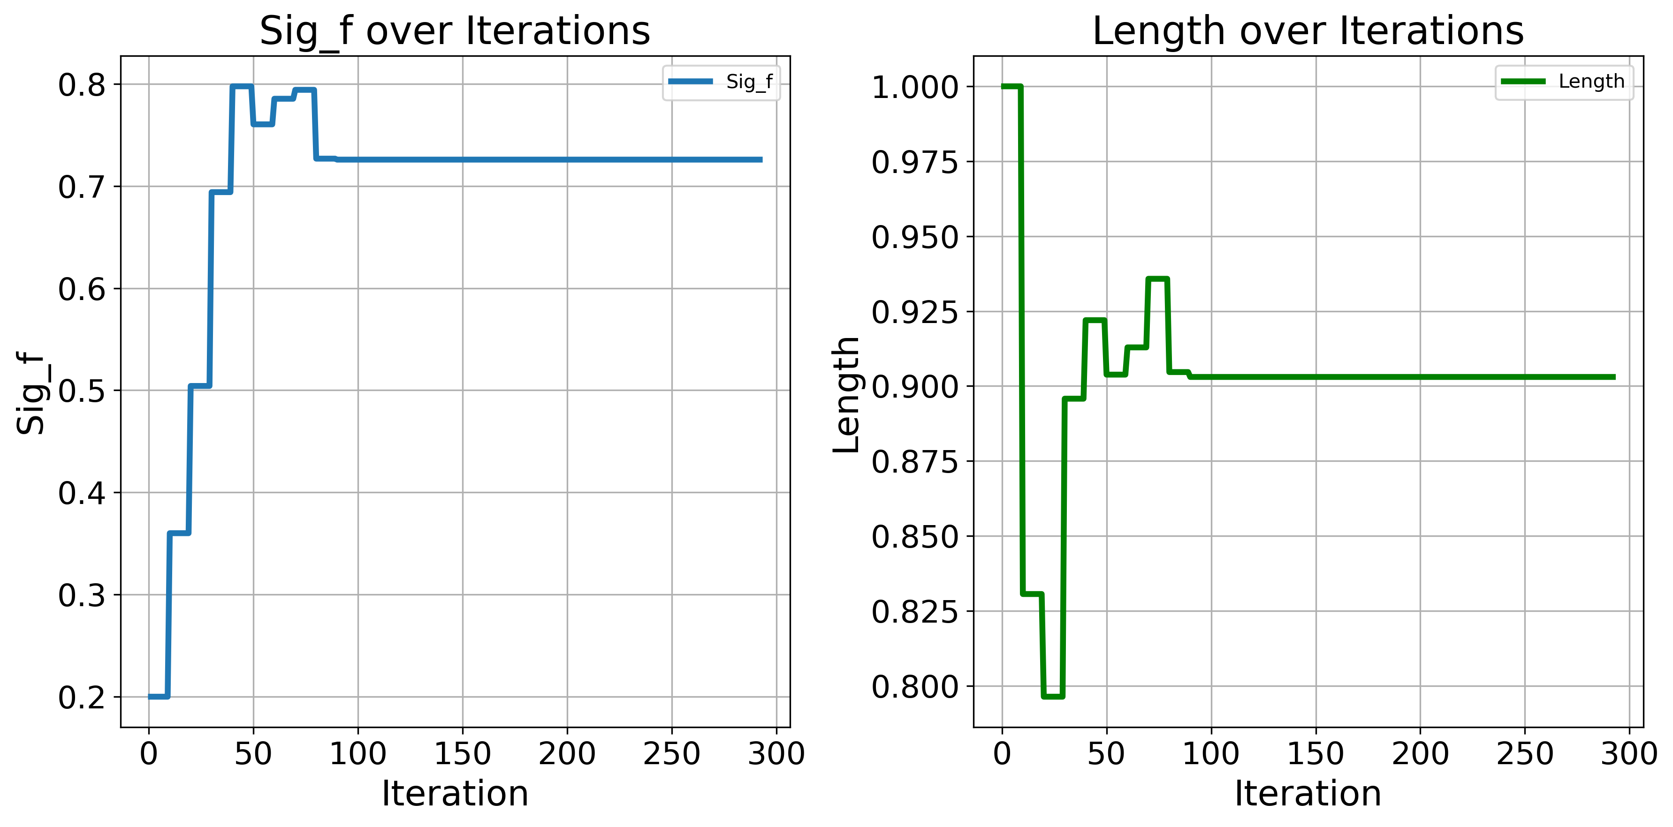
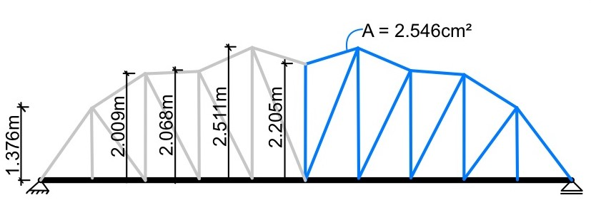
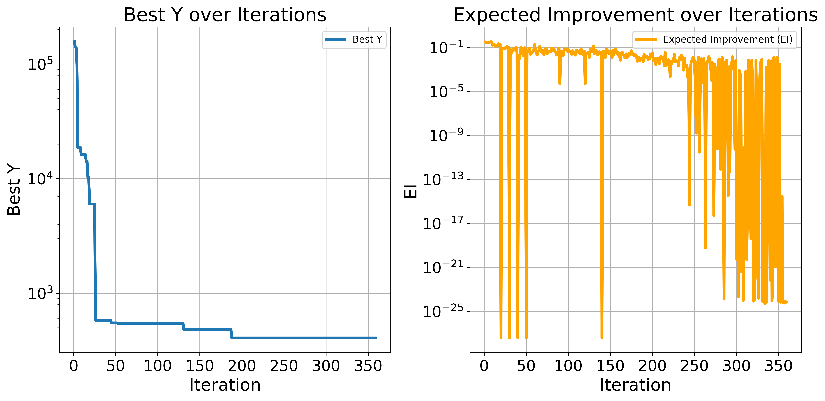
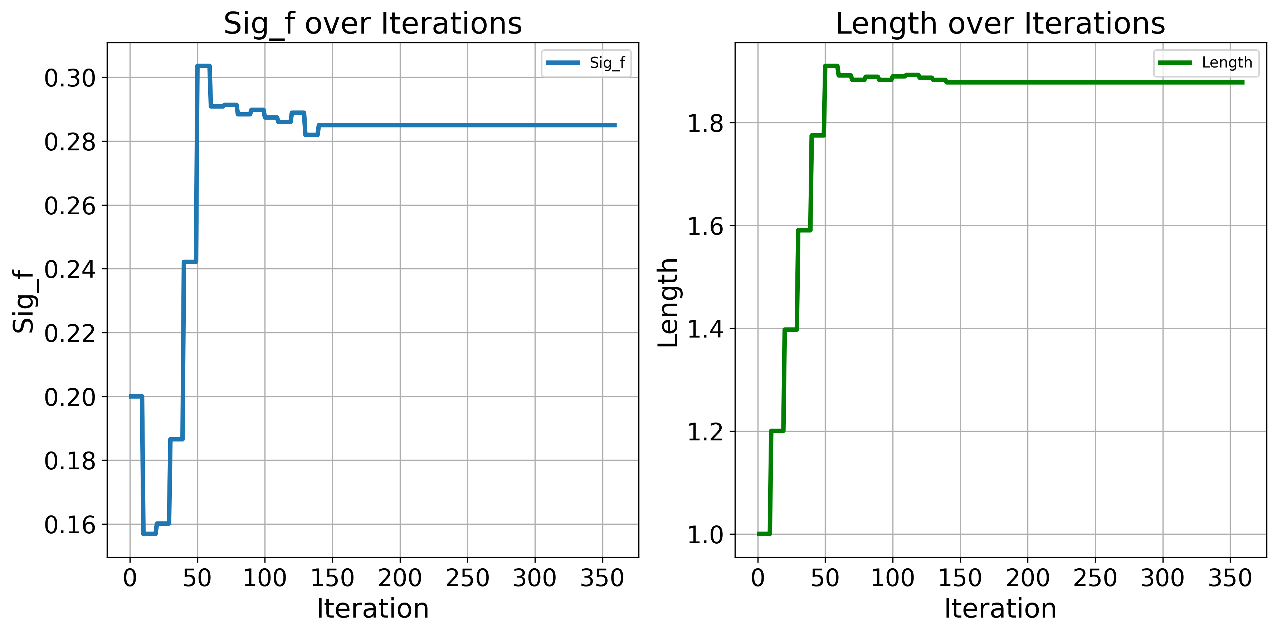
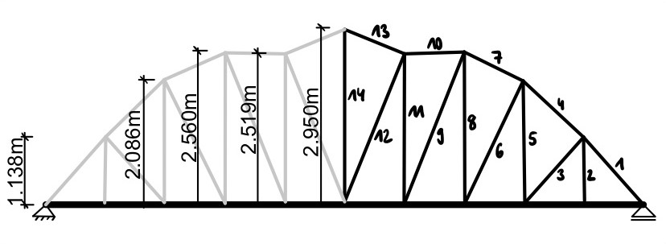
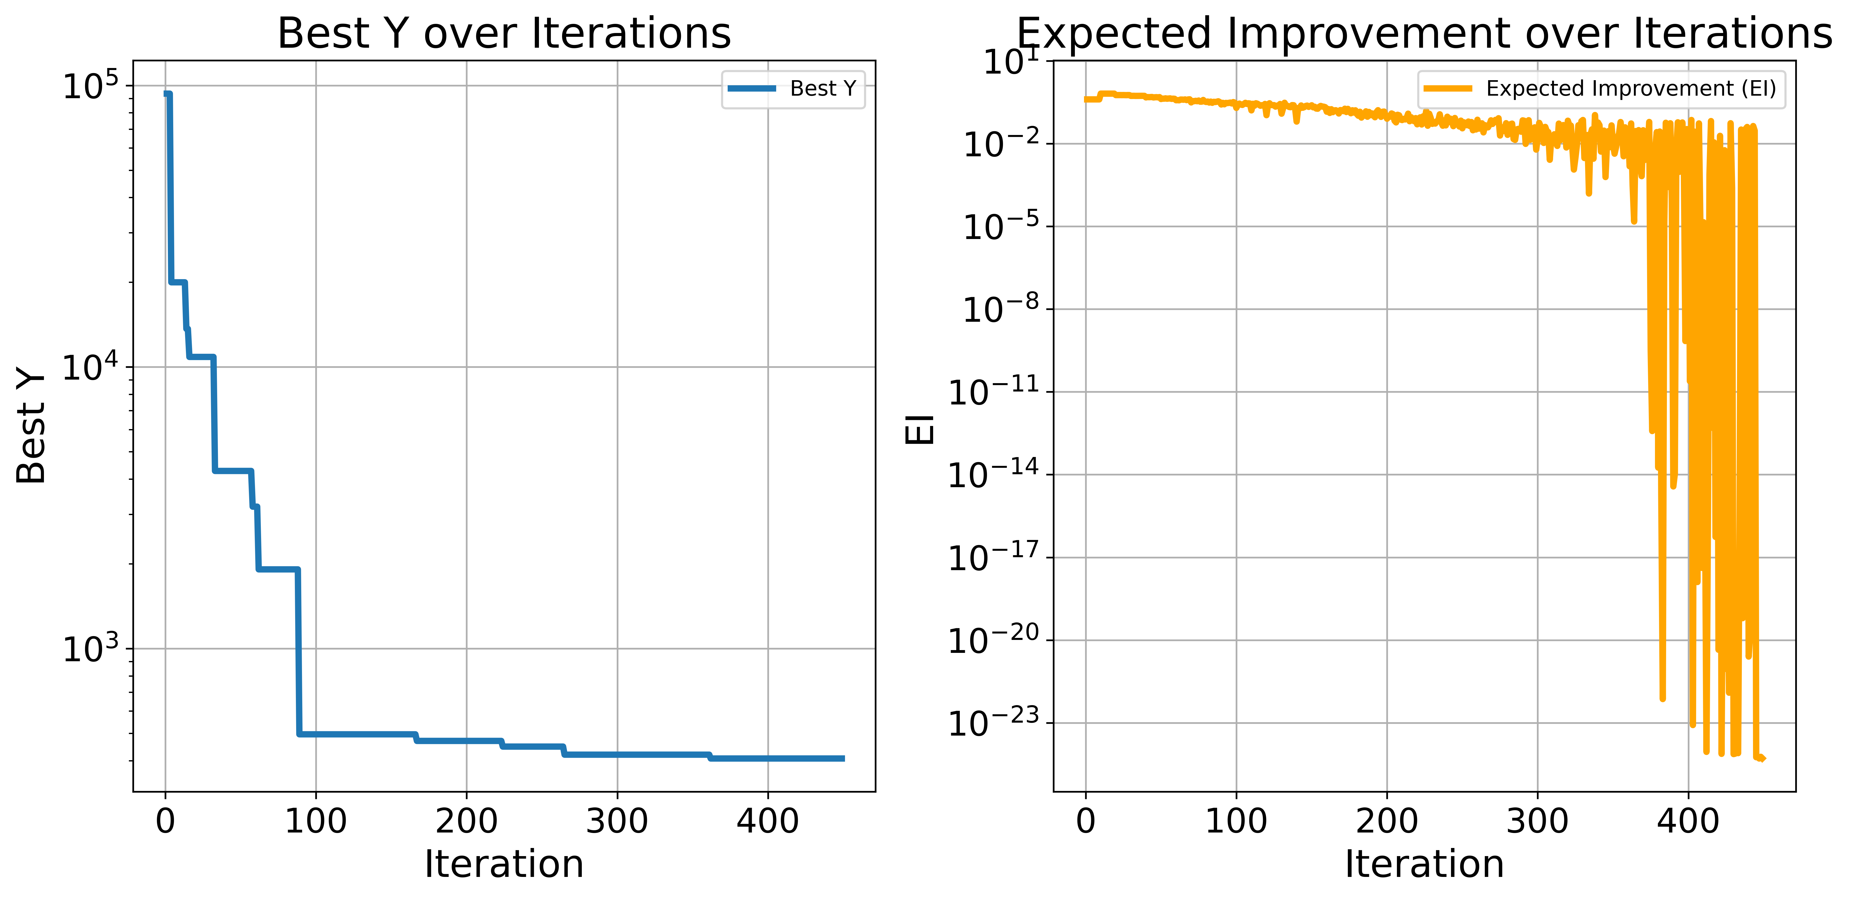
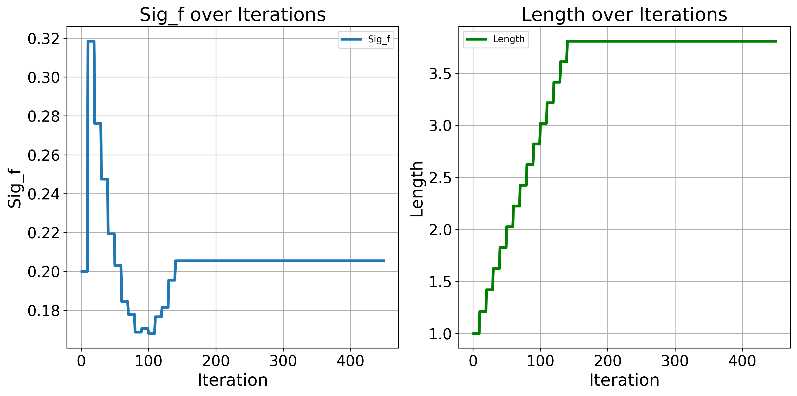
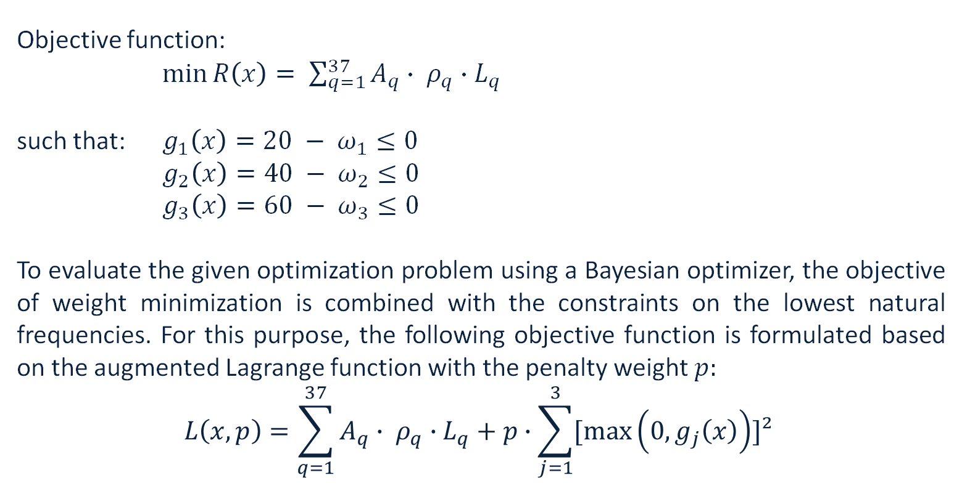
Bayesian optimization for truss structures
TRUSS1: Christiaan Bakker, Robbin Scheurwater, Ekaterina Skorobogatova, Franziska Albrecht
Faculty of Civil Engineering and Geosciences, TU Delft
Data Science and Artificial Intelligence for Engineers | WS 2024-25
Abstract
Hyperparameters
Matern 0.5
Length scale 0 1 2 3 4 5
This project investigates the application of Bayesian optimization to identify an optimal truss design that minimizes weight while meeting structural performance constraints, particularly on natural frequencies. The design space consists of nodal coordinates and cross-sectional properties of truss members, with the goal of minimizing weight while ensuring that the first three natural frequencies satisfy specified thresholds. A Python-based finite element solver is integrated into the Bayesian optimization process, employing a probabilistic surrogate to efficiently guide the search for the global optimum. The framework will be tested on problems of increasing complexity, beginning with simpler 1D and 2D cases and progressing to a 19-dimensional design space. The results include the optimal truss design and an evaluation of the effectiveness of Bayesian optimization for different dimensional problems.
The hyperparameters were tuned for 1D and 2D problems using the Bayesian optimizer. Based on the results for different kernels, it can be concluded that the hyperparameters function has many local minima. Due to the very random nature and different starting points of the Bayesian optimizer, the optimizer rarely converges to the same local minima, regardless of the kernel. The squared exponential kernel has shown the least variety in the values it converged to and required fewer iterations than other kernels. Therefore, that kernel was chosen to proceed.
Length scale
Kernel scale
Length scale
Kernel scale
Length scale
Kernel scale
Length scale
Alpha
M
Matern 1.5
Squared
exponential
Radial
Basis
Function
Introduction
1D – Blue
2D – Red
Results
Kernel scale 0.25 0.5 0.75 1
Truss optimization is important because it enables the design of lightweight, cost-effective, and environmentally sustainable structures. However, evaluating truss structures, which are typically multi-dimensional optimization problems, can be computationally expensive. Compared to meta-heuristic optimization algorithms, the Bayesian optimizer is more data-efficient, as it can incorporate prior knowledge about the function being optimized. In this project, the performance of the Bayesian optimizer is investigated for a truss structure, where the dimensionality is increased step by step. [1, 2]
Alpha/M 0 2 4 6 8 10
ω1 [Hz] | ω2 [Hz] | ω3 [Hz] | Weight [kg]
12.373 | 33.434 | 51.724 | 344.506
1D
Problem formulation
Objective function:
$\min{R\left(x\right)= \sum_{q=1}^{37}{A_{q}∙ ρ_{q}∙L_{q} }}$
such that: $g_{1}\left(x\right)=20 − ω_{1}≤0$
$g_{2}\left(x\right)=40 − ω_{2}≤0$
$g_{3}\left(x\right)=60 − ω_{3}≤0$
To evaluate the given optimization problem using a Bayesian optimizer, the objective of weight minimization is combined with the constraints on the lowest natural frequencies. For this purpose, the following objective function is formulated based on the augmented Lagrange function with the penalty weight $p:$
$$L\left(x, p\right)=\sum_{q=1}^{37}{A_{q}∙ ρ_{q}∙L_{q}+p∙\sum_{j=1}^{3}{[\max\left(0, g_{j}\left(x\right)\right)]²} }$$
Where:
R(x): | weight of the truss structure
A_{q}: | cross section area
Ρ_{q}: | density
L_{q}: | length of the qth truss member
ω1 [Hz] | ω2 [Hz] | ω3 [Hz] | Weight [kg]
19.895 | 50.193 | 75.971 | 407.806
2D
Methodology
Initialization of global variables
Initialization of observation points
Define a Gaussian process as a prior distribution for the objective function
= Surrogate model
Define an aquisition function that determines new sample locations given the posterior distribution
ω1 [Hz] | ω2 [Hz] | ω3 [Hz] | Weight [kg]
21.114 | 45.587 | 70.500 | 407.475
6D
Define new candidate points by maximizing the aquisition function
i ≤ max. iterations
Evaluate the objective function with the new candidate point
Update covariance matrix
END
i > max. iterations
Conclusion
In this project, the application of Bayesian optimization to a truss structure was demonstrated in order to achieve a minimum structural weight while meeting the natural frequency constraints. In the 1D and 2D cases, the Bayesian optimizer was able to find the optimal solution within a few iterations, showing that this method is extremely effective for low-dimensional optimization problems. However, in the higher-dimensional cases (6D and 19D), the Bayesian optimizer required significantly more initial points to find a near-optimal solution, and the optimal solution reported in [1] was never achieved. The difficulties encountered in the 6D and 19D cases are consistent with the statement in [2] that extending the Bayesian optimization to high-dimensional problems remains a critical open challenge.
ω1 [Hz] | ω2 [Hz] | ω3 [Hz] | Weight [kg]
20.508 | 40.202 | 63.945 | 406.965
19D
Optimal cross sections [cm²]
A1 | 1.852 | A6 | 3.693 | A11 | 2.667
A2 | 2.313 | A7 | 1.734 | A12 | 1.499
A3 | 2.588 | A8 | 3.453 | A13 | 2.915
A4 | 2.903 | A9 | 2.093 | A14 | 1.235
A5 | 2.192 | A10 | 2.109
References:
[1] Kanarachos, S., Griffin, J., Fitzpatrick, M. E. (2017). Efficient truss optimization using the contrast-based fruit fly optimization algorithm. Computers and Structures, 182, 137-148
[2] Wang, X., Jin, Y., Schmitt, S., Olhofer, M. (2023). Recent Advances in Bayesian Optimization. ACM Computing Surveys, 55(13), 1-36. https://doi.org/10.1145/3582078
[3] Vink, R. (2019, August 25). Algorithm Breakdown: Bayesian Optimization. Ritchie Vink. https://www.ritchievink.com/blog/2019/08/25/algorithm-breakdown-bayesian-optimization/

Slide 2
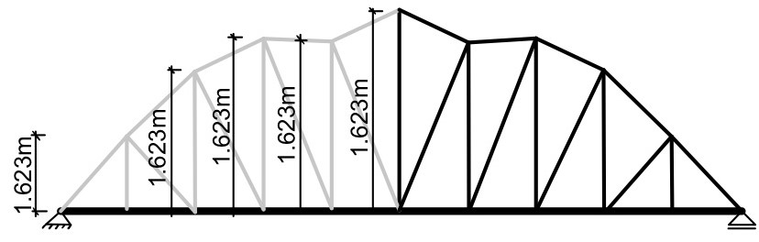

Bayesian optimization for truss structures
Christiaan Bakker, Robbin Scheurwater, Ekaterina Skorobogatova, Franziska Albrecht
Faculty of Civil Engineering and Geosciences, TU Delft
Data Science and Artificial Intelligence for Engineers | WS 2024-25
Abstract
This project investigates the application of Bayesian optimization to identify an optimal truss design that minimizes weight while meeting structural performance constraints, particularly on natural frequencies. The design space consists of nodal coordinates and cross-sectional properties of truss members, with the goal of minimizing weight while ensuring that the first three natural frequencies satisfy specified thresholds. A Python-based finite element solver is integrated into the Bayesian optimization process, employing a probabilistic surrogate to efficiently guide the search for the global optimum. The framework will be tested on problems of increasing complexity, beginning with simpler 1D and 2D cases and progressing to a 19-dimensional design space. The results include the optimal truss design and an evaluation of the effectiveness of Bayesian optimization for different dimensional problems.
Introduction
Results
Truss optimization is important because it enables the design of lightweight, cost-effective, and environmentally sustainable structures. However, evaluating truss structures, which are typically multi-dimensional optimization problems, can be computationally expensive. Compared to meta-heuristic optimization algorithms, the Bayesian optimizer is more data-efficient, as it can incorporate prior knowledge about the function being optimized. In this project, the performance of the Bayesian optimizer is investigated for truss structure, where the dimensionality is increased step by step. [1, 2]
ω1 [Hz] | ω2 [Hz] | ω3 [Hz] | Weight [kg]
12.373 | 33.434 | 51.724 | 344.506
1D
Problem formulation
Objective function:
$\min{R\left(x\right)= \sum_{q=1}^{37}{A_{q}∙ ρ_{q}∙L_{q} }}$
such that: $g_{1}\left(x\right)=20 − ω_{1}≤0$
$g_{2}\left(x\right)=40 − ω_{2}≤0$
$g_{3}\left(x\right)=60 − ω_{3}≤0$
To evaluate the given optimization problem using a Bayesian optimizer, the objective of weight minimization is combined with the constraints on the lowest natural frequencies. For this purpose, the following objective function is formulated based on the augmented Lagrange function with the penalty weight $p:$
$$L\left(x, p\right)=\sum_{q=1}^{37}{A_{q}∙ ρ_{q}∙L_{q}+p∙\sum_{j=1}^{3}{[\max\left(0, g_{j}\left(x\right)\right)]²} }$$
Where:
R(x): | weight of the truss structure
A_{q}: | cross section area
Ρ_{q}: | density
L_{q}: | length of the qth truss member
ω1 [Hz] | ω2 [Hz] | ω3 [Hz] | Weight [kg]
19.895 | 50.193 | 75.971 | 407.806
2D
Methodology
Initialization of global variables
Initialization of observation points
Define a Gaussian process as a prior distribution for the objective function
= Surrogate model
Define an aquisition function that determines new sample locations given the posterior distribution
Define new candidate points by maximizing the aquisition function
i ≤ max. iterations
Evaluate the objective function with the new candidate point
Update covariance matrix
6D
END
i > max. iterations
Optimal cross sections
A1
- | - | -
ω1 [Hz] | ω2 [Hz] | ω3 [Hz] | Weight [kg]
- | - | - | -
Conclusion
19D
In this project, the application of Bayesian optimization to a truss structure was demonstrated in order to achieve a minimum structural weight while meeting the natural frequency constraints. In the 1D and 2D cases, the Bayesian optimizer was able to find the optimal solution within a few iterations, showing that this method is extremely effective for low-dimensional optimization problems. However, in the higher-dimensional cases (6D and 19D), the Bayesian optimizer required significantly more initial points to find a near-optimal solution, and the optimal solution reported in [1] was never achieved. The difficulties encountered in the 6D and 19D cases are consistent with the statement in [2] that extending the Bayesian optimization to high-dimensional problems remains a critical open challenge.
References:
[1] Kanarachos, S., Griffin, J., Fitzpatrick, M. E. (2017). Efficient truss optimization using the contrast-based fruit fly optimization algorithm. Computers and Structures, 182, 137-148
[2] Wang, X., Jin, Y., Schmitt, S., Olhofer, M. (2023). Recent Advances in Bayesian Optimization. ACM Computing Surveys, 55(13), 1-36. https://doi.org/10.1145/3582078
[3] Vink, R. (2019, August 25). Algorithm Breakdown: Bayesian Optimization. Ritchie Vink. https://www.ritchievink.com/blog/2019/08/25/algorithm-breakdown-bayesian-optimization/

